Slide 1
HACKATHON PROJECT: AUTOMATIC STUDENT ATTENDANCE AND ANALYTIC SYSTEM FOR COLLEGES
BY:
Abhilasha J M:1BM25AD406-T
Sanchitha Kolur:1BM24AD056
Vishrutha Shekar:1BM24AD069

Slide 2
PROBLEM STATEMENT:
Traditional attendance methods like roll calls and ID cards are slow, error-prone, and easily manipulated. This causes inefficiency and administrative burden. Hence, there is a need for a smart, contactless, and automated system that ensures real-time and accurate attendance tracking.

Slide 3
PROJECT OBJECTIVE:
1. Automated Recognition: Develop an AI-based system that detects and identifies registered users through a webcam.
2. Accurate Attendance: Record attendance with precise login and logout timestamps while preventing duplicates or proxy entries.
3. Easy Enrollment: Enable quick registration via camera capture or photo upload.
4. Real-Time Reporting: Provide live attendance reports and analytics through a web-based dashboard.

Slide 4
SYSTEM ARCHICHECTURE OVERVIEW:
User Enrollment: Students upload or capture multiple facial images, and the system extracts and stores unique face embeddings in a CSV-based database.
2. Real-Time Recognition: The webcam captures live frames, detects faces, and compares embeddings with stored data using a similarity threshold.
3. Attendance Marking: When a match is found, attendance (with date and time) is recorded; unmatched faces are labeled as “Unknown.”
4. Attendance Management: All login and logout events are saved in attendance.csv, allowing dynamic tracking.
5. Dashboard & Reports: An admin dashboard shows attendance summaries, statistics, and allows CSV export for official records.

Slide 5
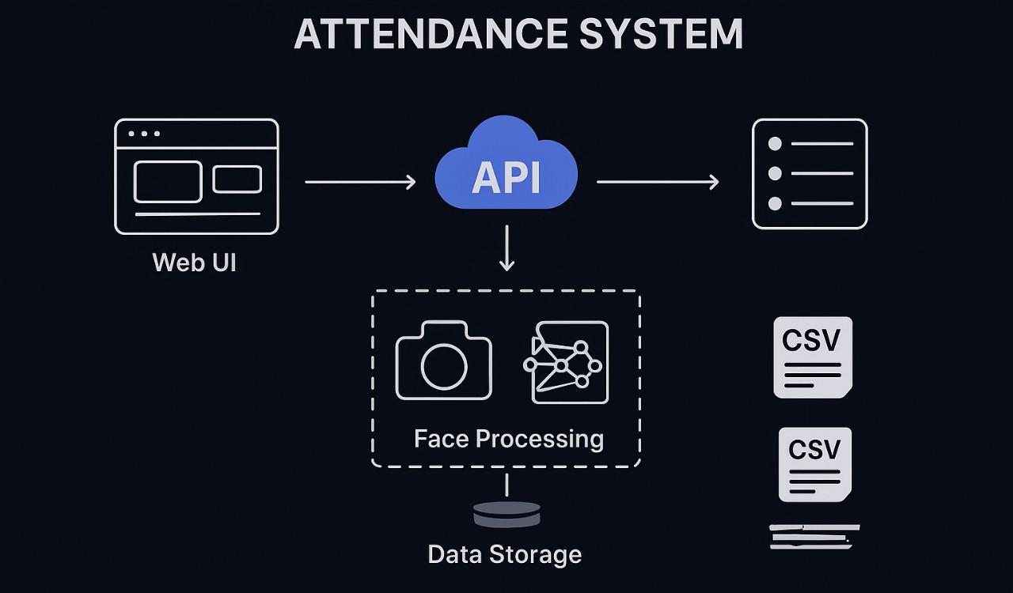

Slide 6
KEY COMPONENTS
Flask Web Server :Backend framework handling routes, APIs, and templates.
Deep Face Library : Provides face detection and feature extraction using pre-trained models.
Facenet512 Model : Deep learning model used for face embedding generation (lightweight & accurate).
Open CV : Captures and processes images from the webcam.
Bootstrap 5 + SweetAlert2: Used in frontend for responsive UI and real-time pop-ups.
Pandas & NumPy : Manage CSV data (enrollment, embeddings, attendance).
JavaScript (Fetch API): Handles asynchronous communication between the frontend and Flask API.

Slide 7
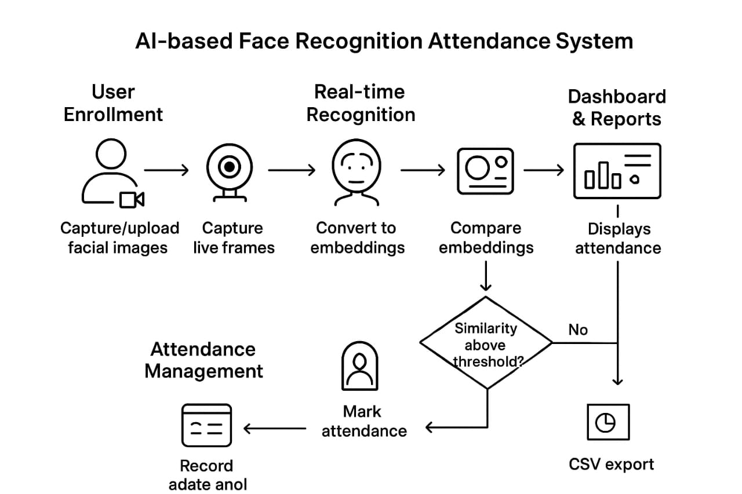

Slide 8
STEP-BY-STEP WORKING EXPLANATION
1. Enrollment (Register students)
• Capture multiple face photos via webcam or upload.
• Preprocess (crop, align, normalize) and run the face model to extract a fixed-length embedding vector.
• Store the averaged embedding plus student metadata in embeddings.csv / enrollment.csv.
2. Real-time Recognition (Live attendance capture)
• Webcam continuously grabs frames; each frame is checked for faces and landmarks.
• For each detected face, generate an embedding and compute distance to stored embeddings.

Slide 9
3. Attendance logging & duplicate prevention
• Recognitions write timestamped entries to attendance.csv (login/logout).
• Logic checks prevent duplicate entries (e.g., only one login per day or require logout before a new login).
4. Logout & session handling
• Manual logout or inactivity-triggered logout records logout_time for that session in attendance.csv.
5. Dashboard & reports
• Backend (Flask + Pandas) reads CSVs, computes totals (registered / present / absent / last seen) and serves the dashboard.
• Admin can view daily reports and export CSVs for record-keeping.

Slide 10
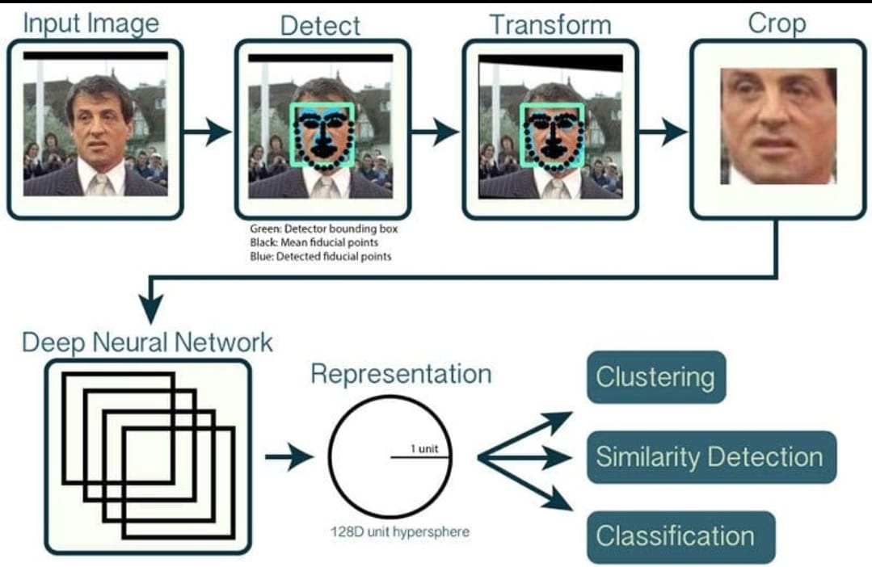

Slide 11
BENEFITS OF THE MODEL
1. ⏱️ Time-Efficient & Contactless
Attendance is marked automatically within seconds using facial recognition — no manual effort, cards, or fingerprints required.
2. 🎯 High Accuracy & Reliability
Deep learning models like Facenet512 and DeepFace ensure precise identification, minimizing false positives and proxy attendance.
3. 🙌 Eliminates Proxy & Duplication
Each person’s facial embedding is unique, preventing others from marking attendance on their behalf.
4. 📈 Real-Time Monitoring & Analytics
The web dashboard provides instant updates on attendance, absentees, and login/logout timings, enhancing transparency and control.
5. 💻 Easy Integration & Scalability
Built using Flask, OpenCV, and CSV-based storage, the system can easily be extended to databases or cloud services for larger institutions.

Slide 12
FUTURE SCOPE
1. Cloud Integration – Store data and run recognition on cloud servers for scalability and remote access.
2. Mobile App Support – Develop Android/iOS apps for attendance marking and live monitoring.
3. Database Upgrade – Replace CSV files with SQL or MongoDB for better performance and security.
4. Multi-Camera Support – Enable recognition from multiple cameras across different classrooms or offices.

Slide 13
THANK YOU!

